Slide 1
Information Graphics
Steven King
@steven_king
steven.king@unc.edu

Slide 2
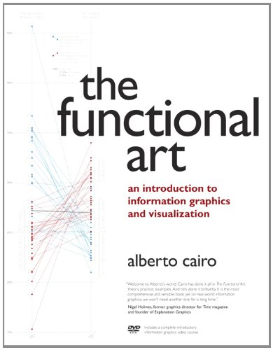
Resource
Alberto Cairo is the leader in this field and wrote a great text book.

Slide 3
Are infographics art?

Slide 4

Fernando Baptista National Geographic magazine

Slide 5
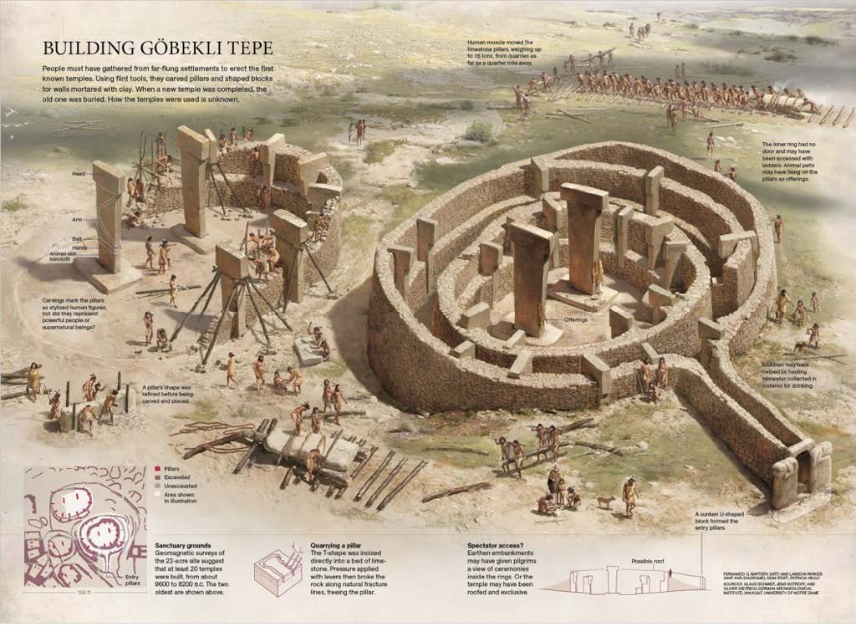

Slide 6
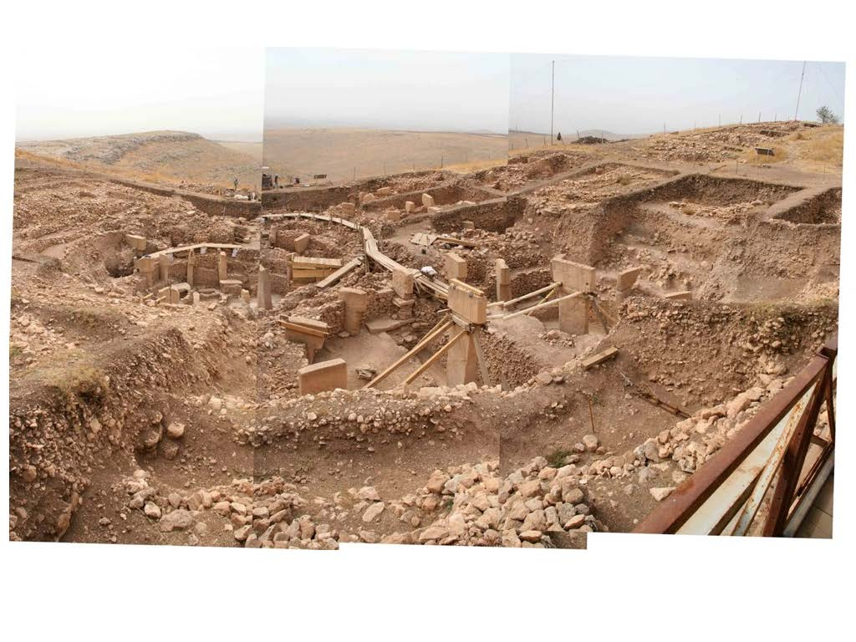

Slide 7
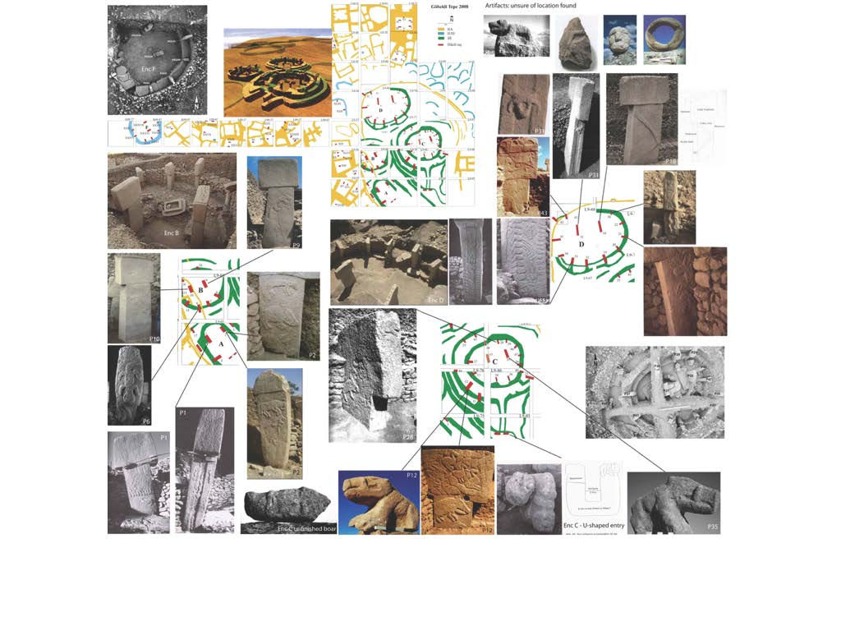

Slide 8
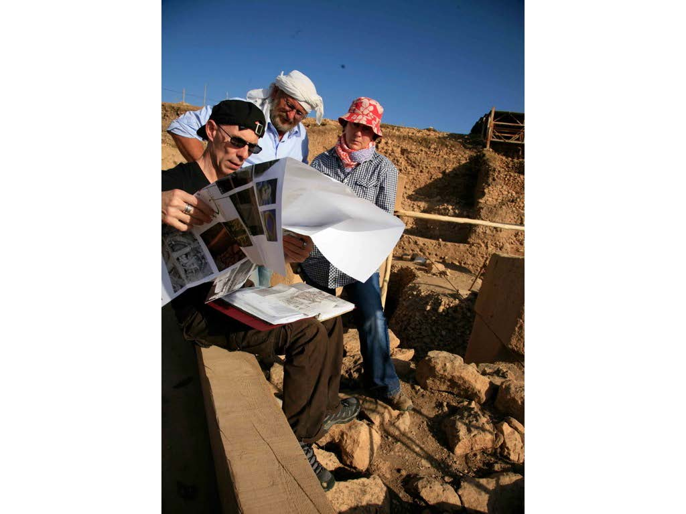
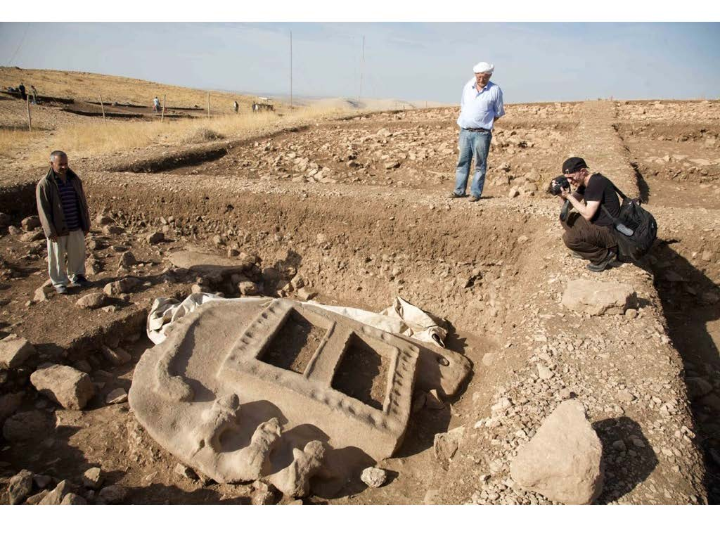

Slide 9
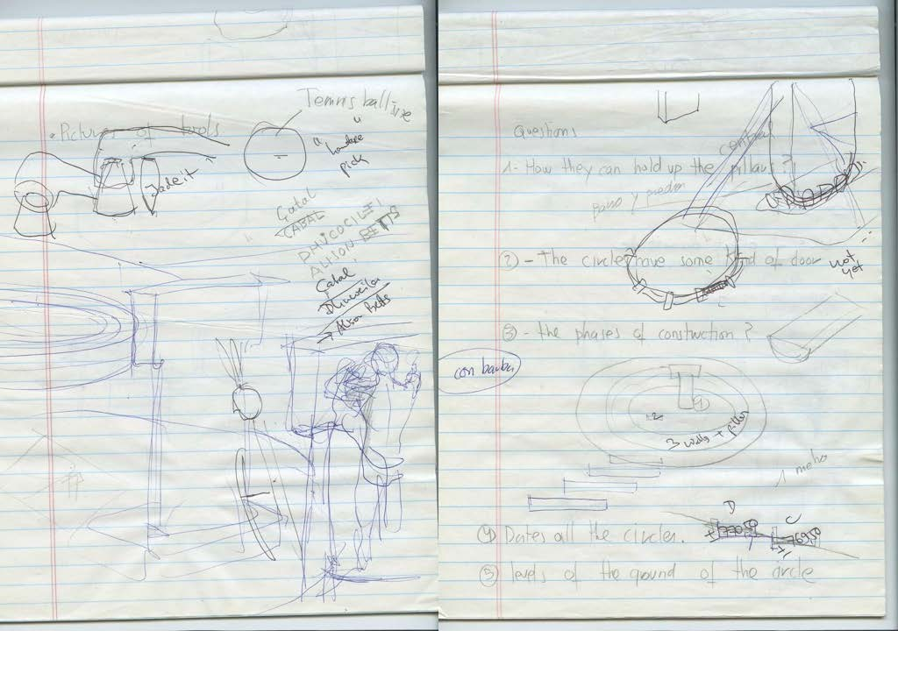

Slide 10
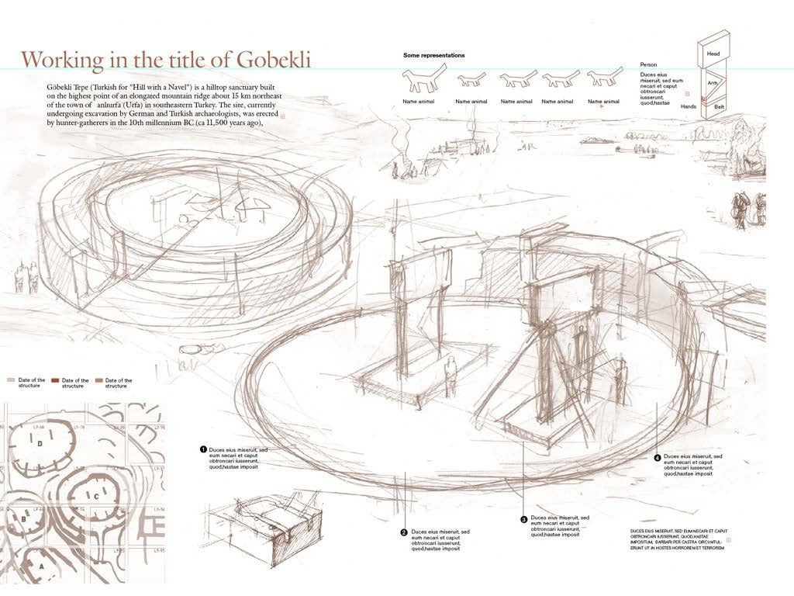

Slide 11
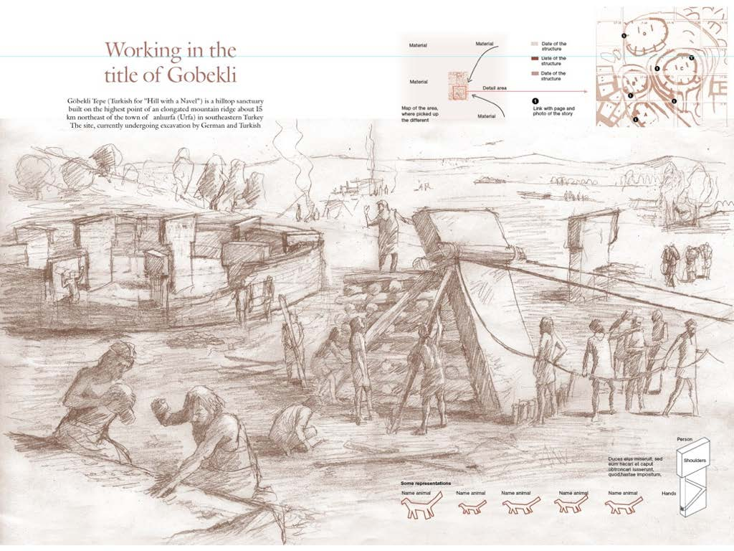

Slide 12
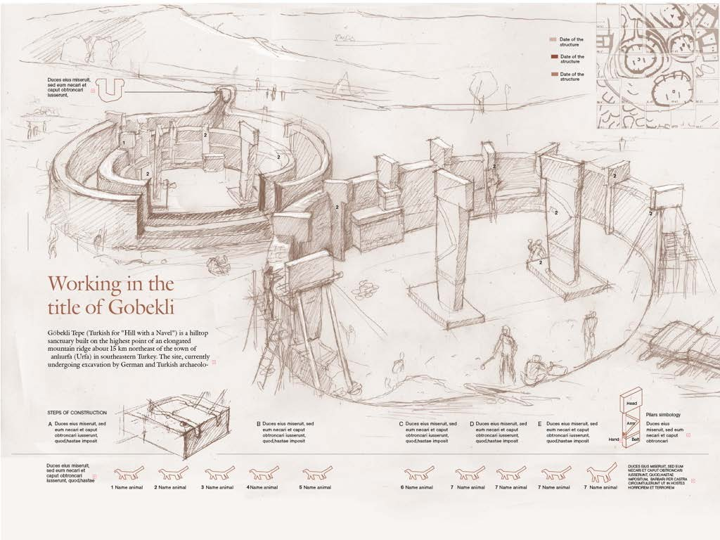

Slide 13
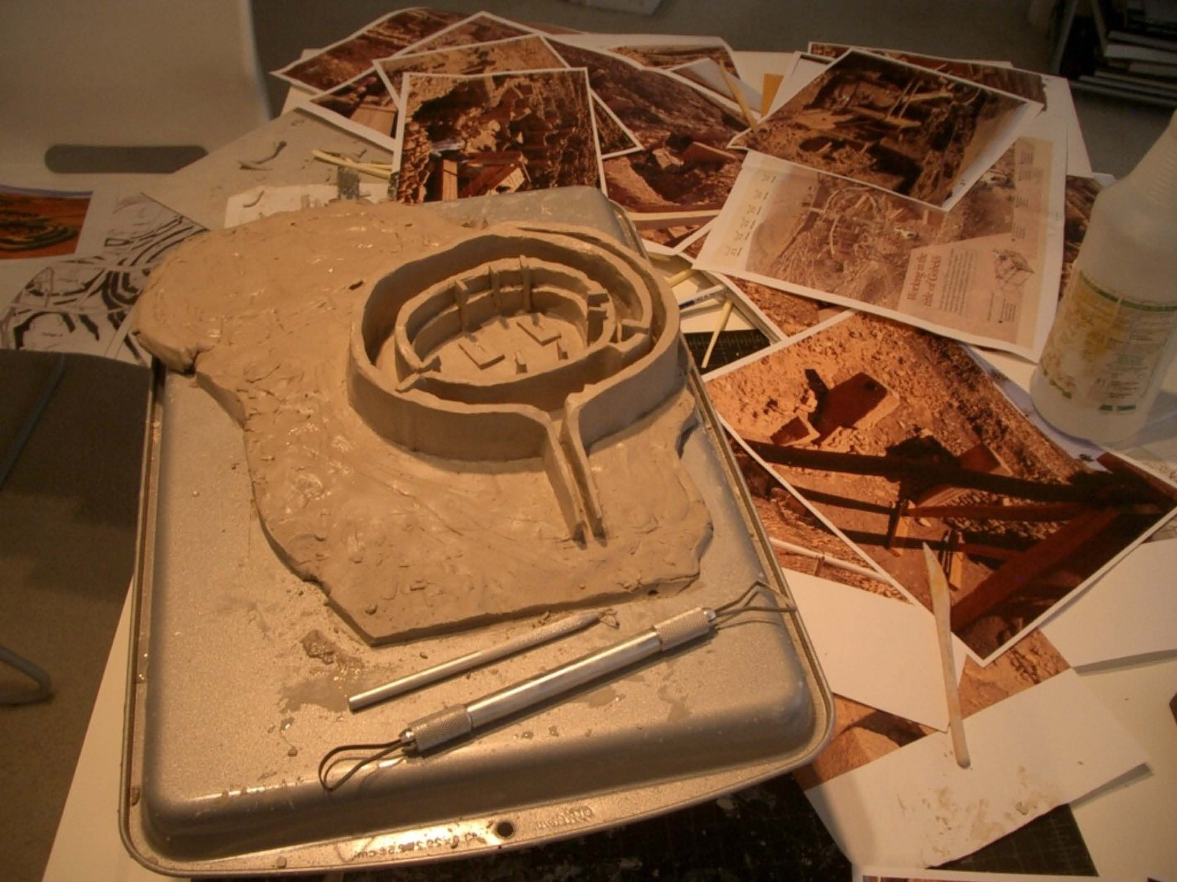

Slide 14
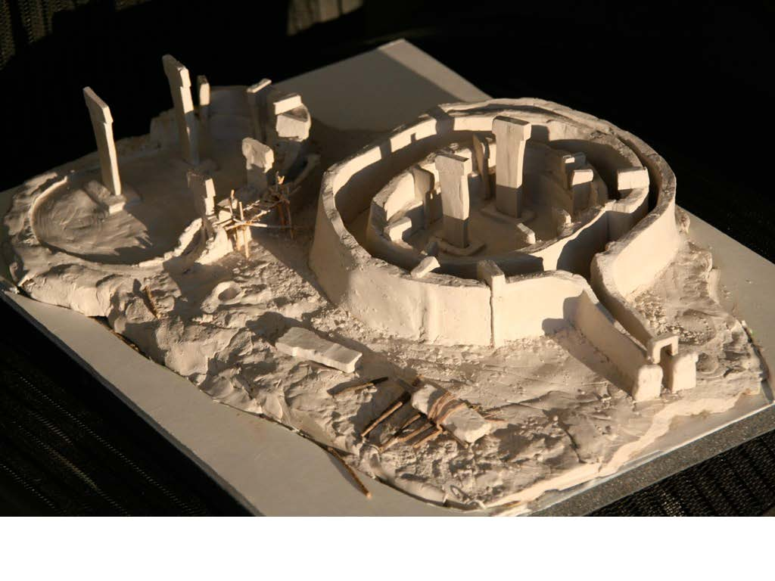

Slide 15
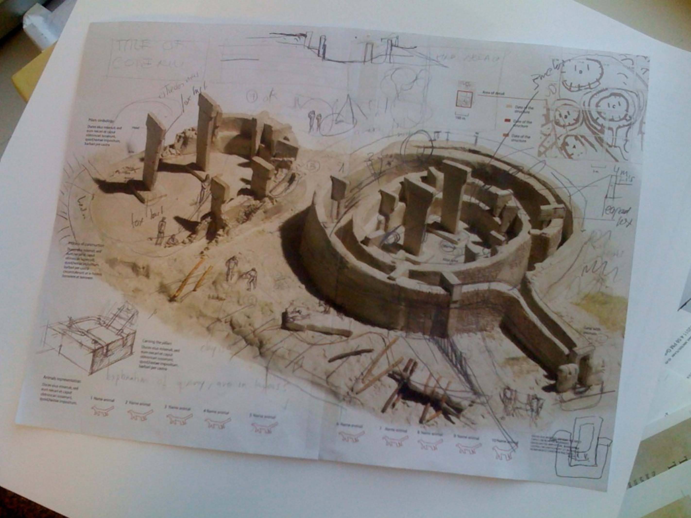

Slide 16
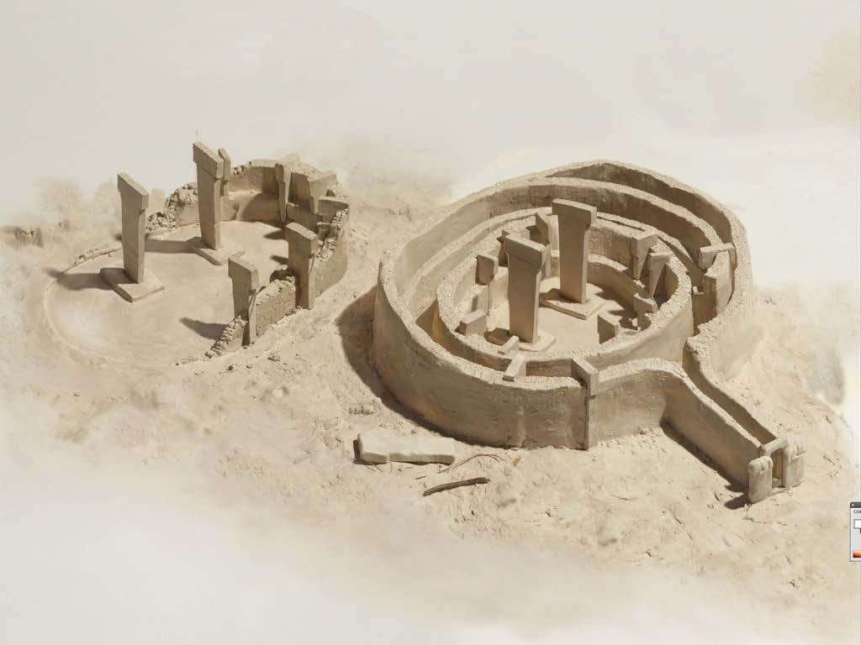

Slide 17
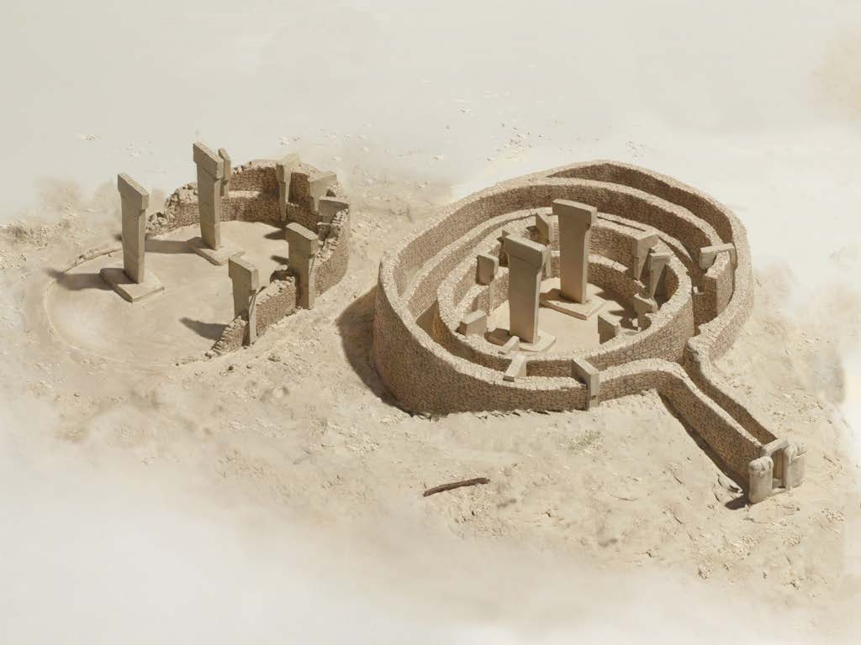

Slide 18
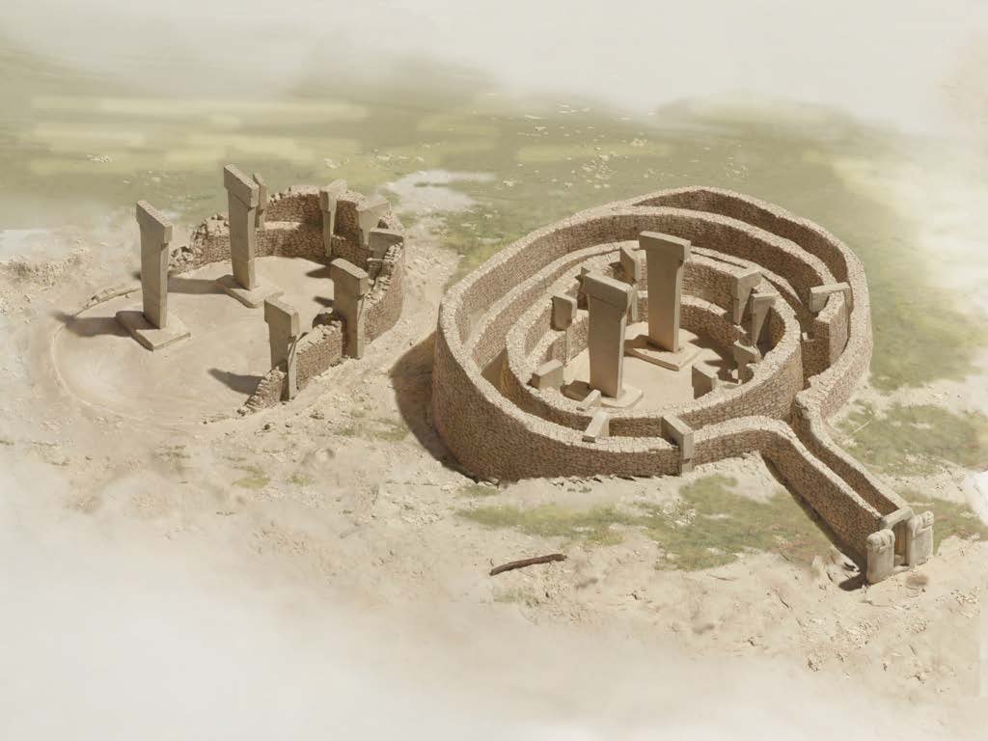

Slide 19
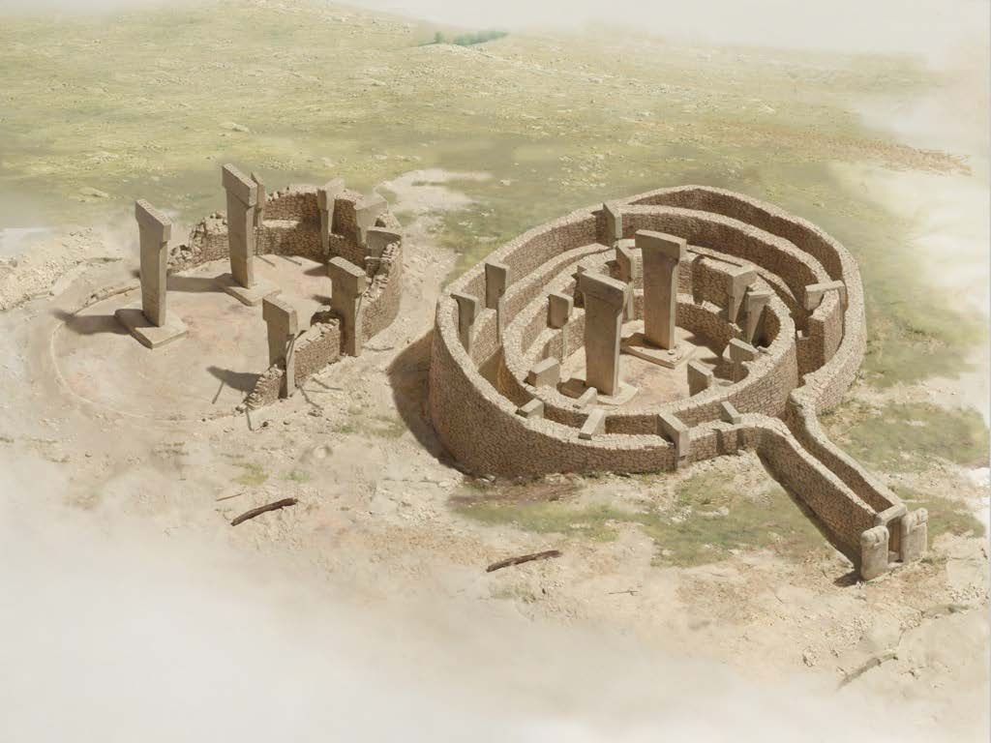

Slide 20
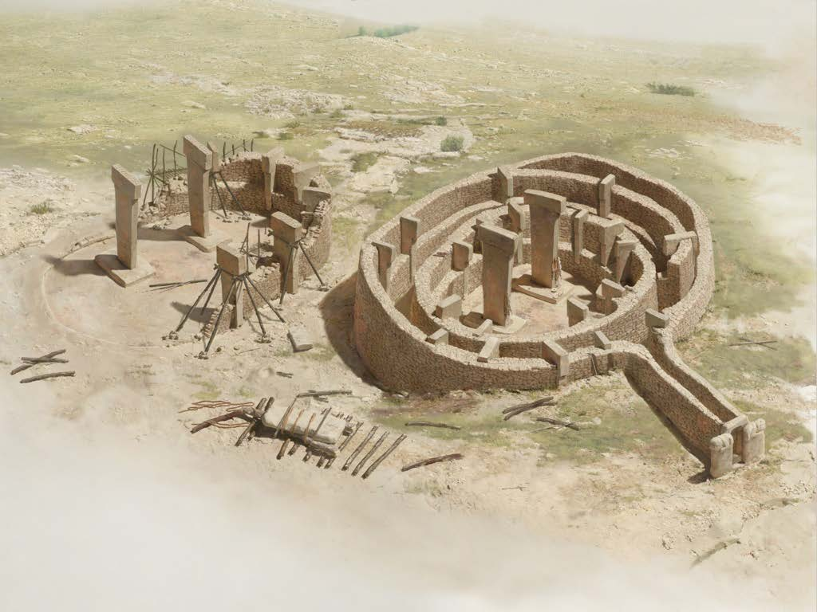

Slide 21
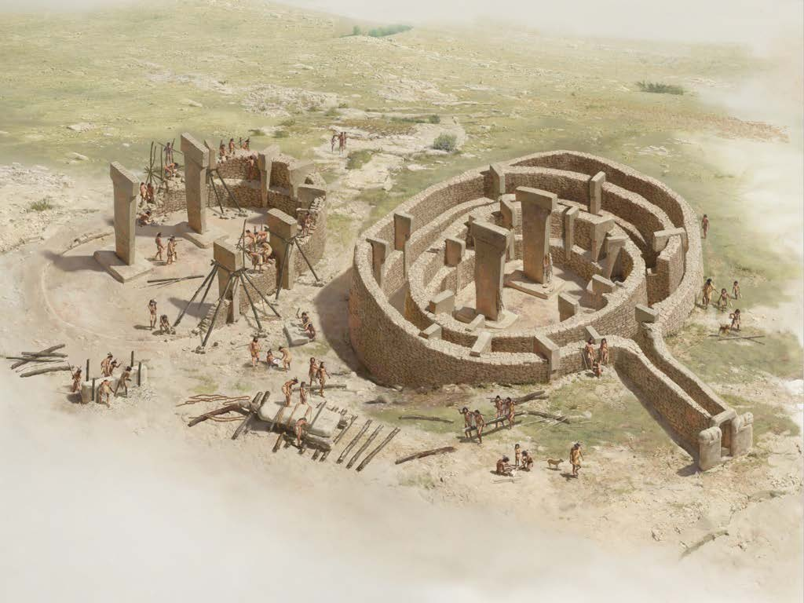

Slide 22
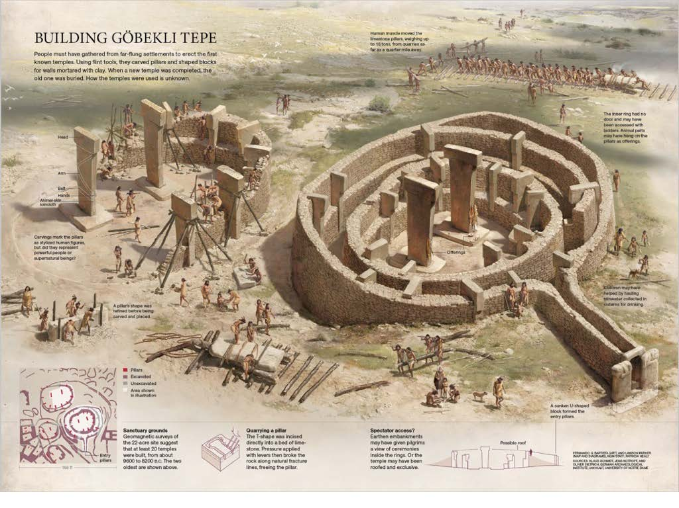

Slide 23
Are Infographics News?

Slide 24
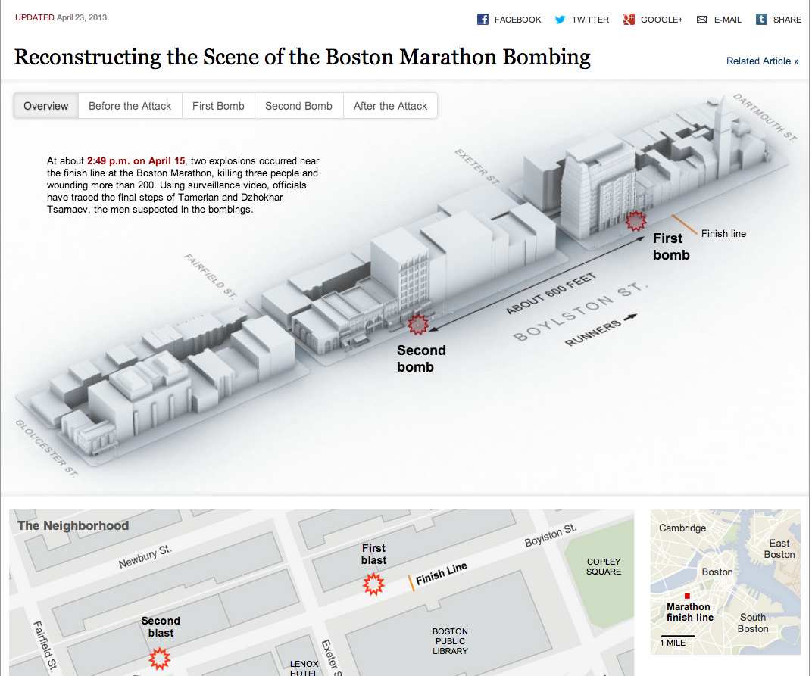
http://www.nytimes.com/interactive/2013/04/17/us/caught-in-the-blast-at-the-boston-marathon.html?ref=us

Slide 25
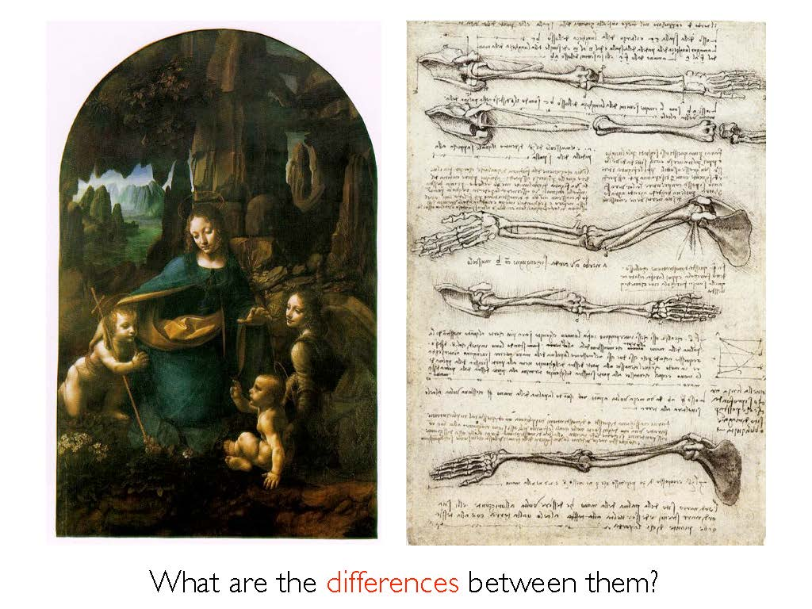
What is the difference between art and functional art?

Slide 26
Art?
Thinking that infographics are just ‘art” leads to wrong priorities.

Slide 27
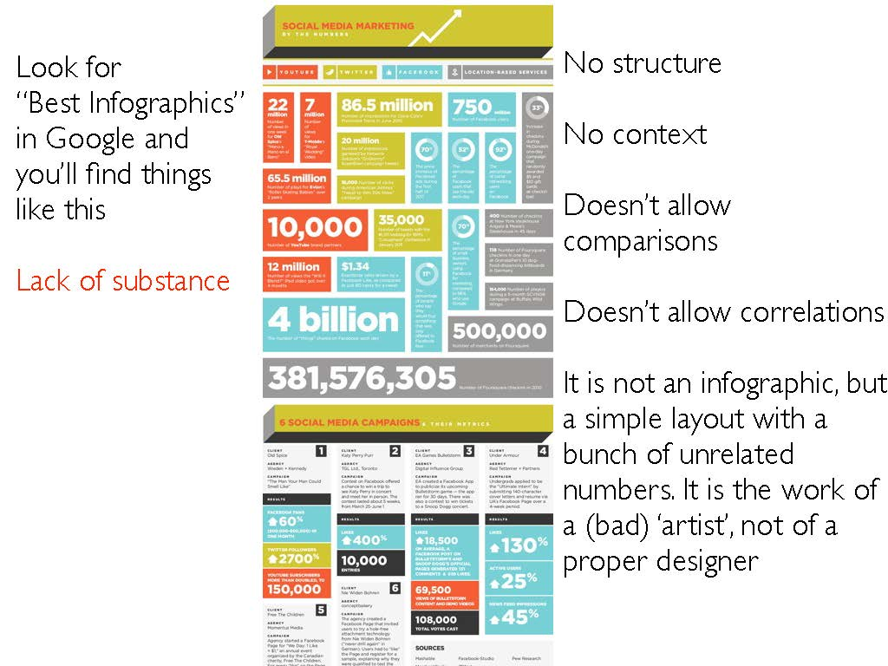

Slide 28
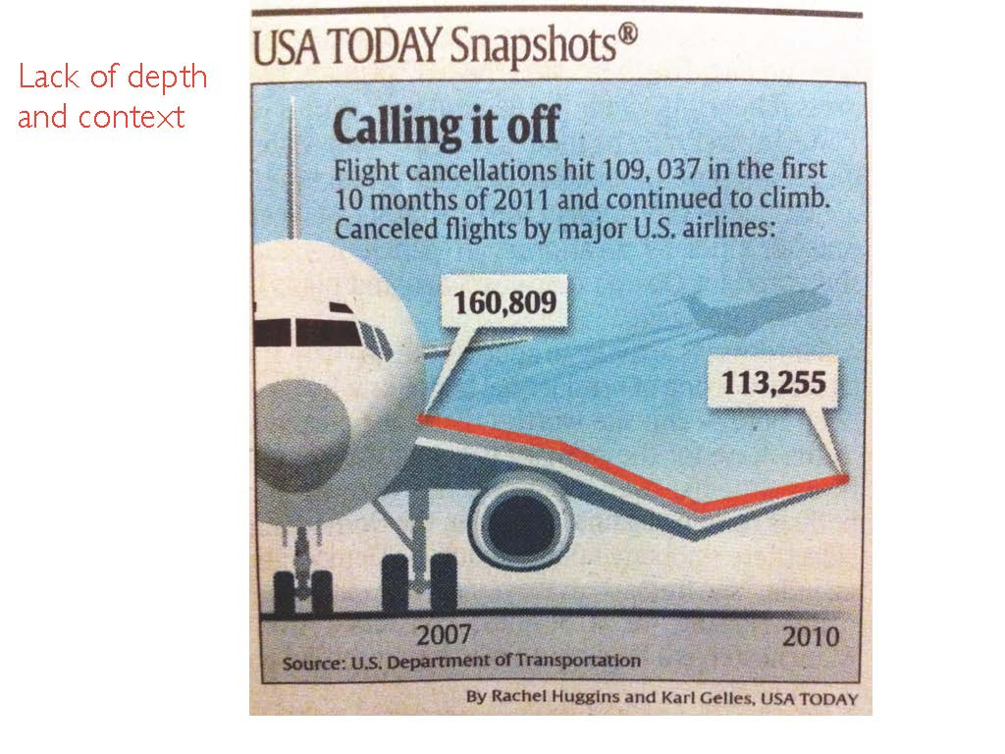

Slide 29
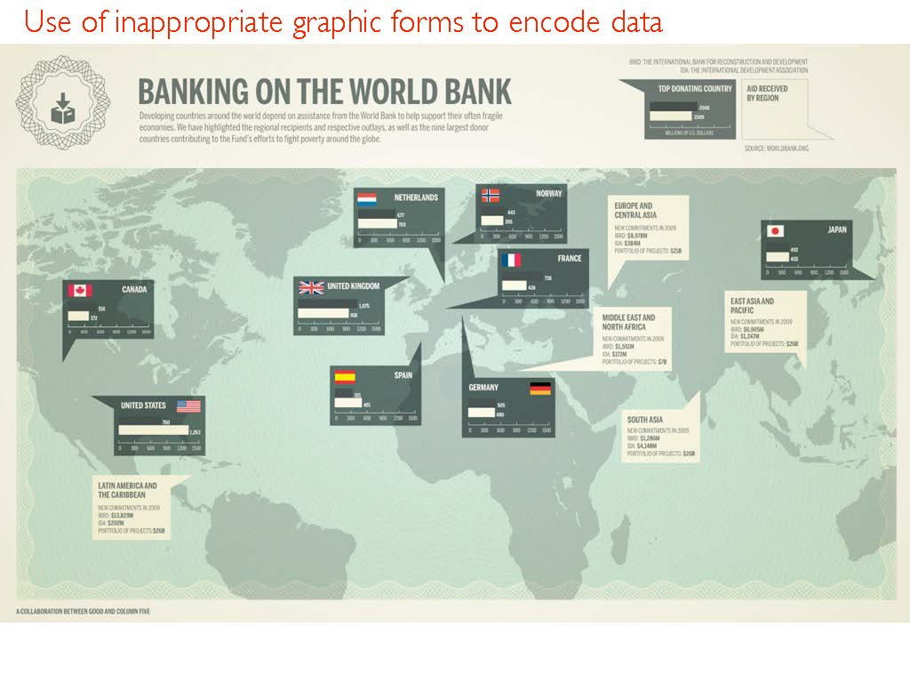

Slide 30
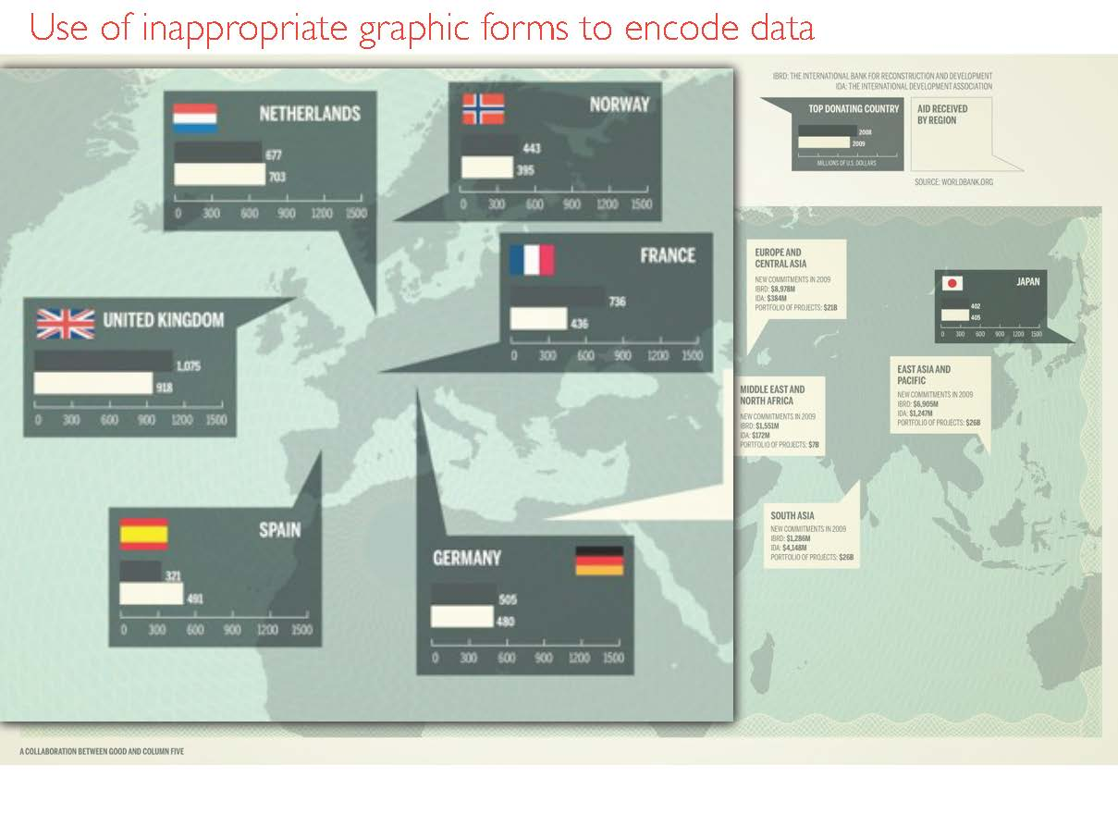

Slide 31
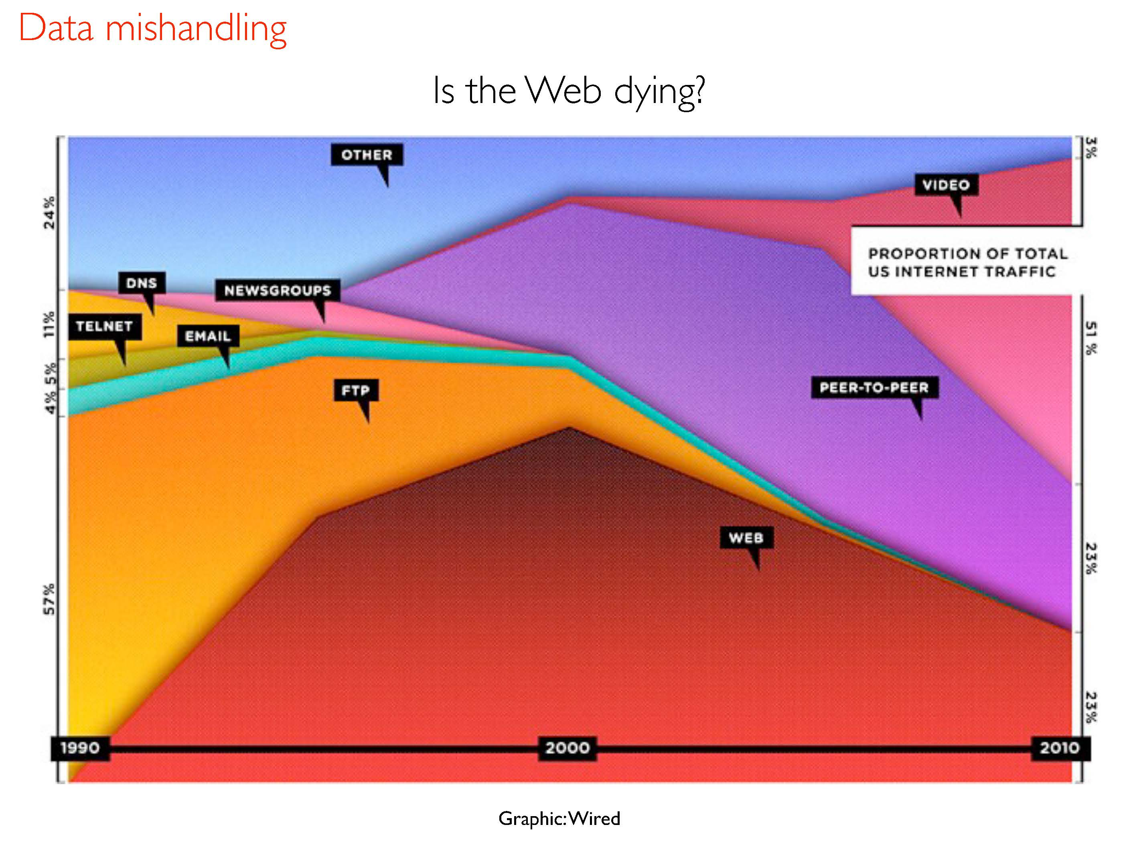

Slide 32
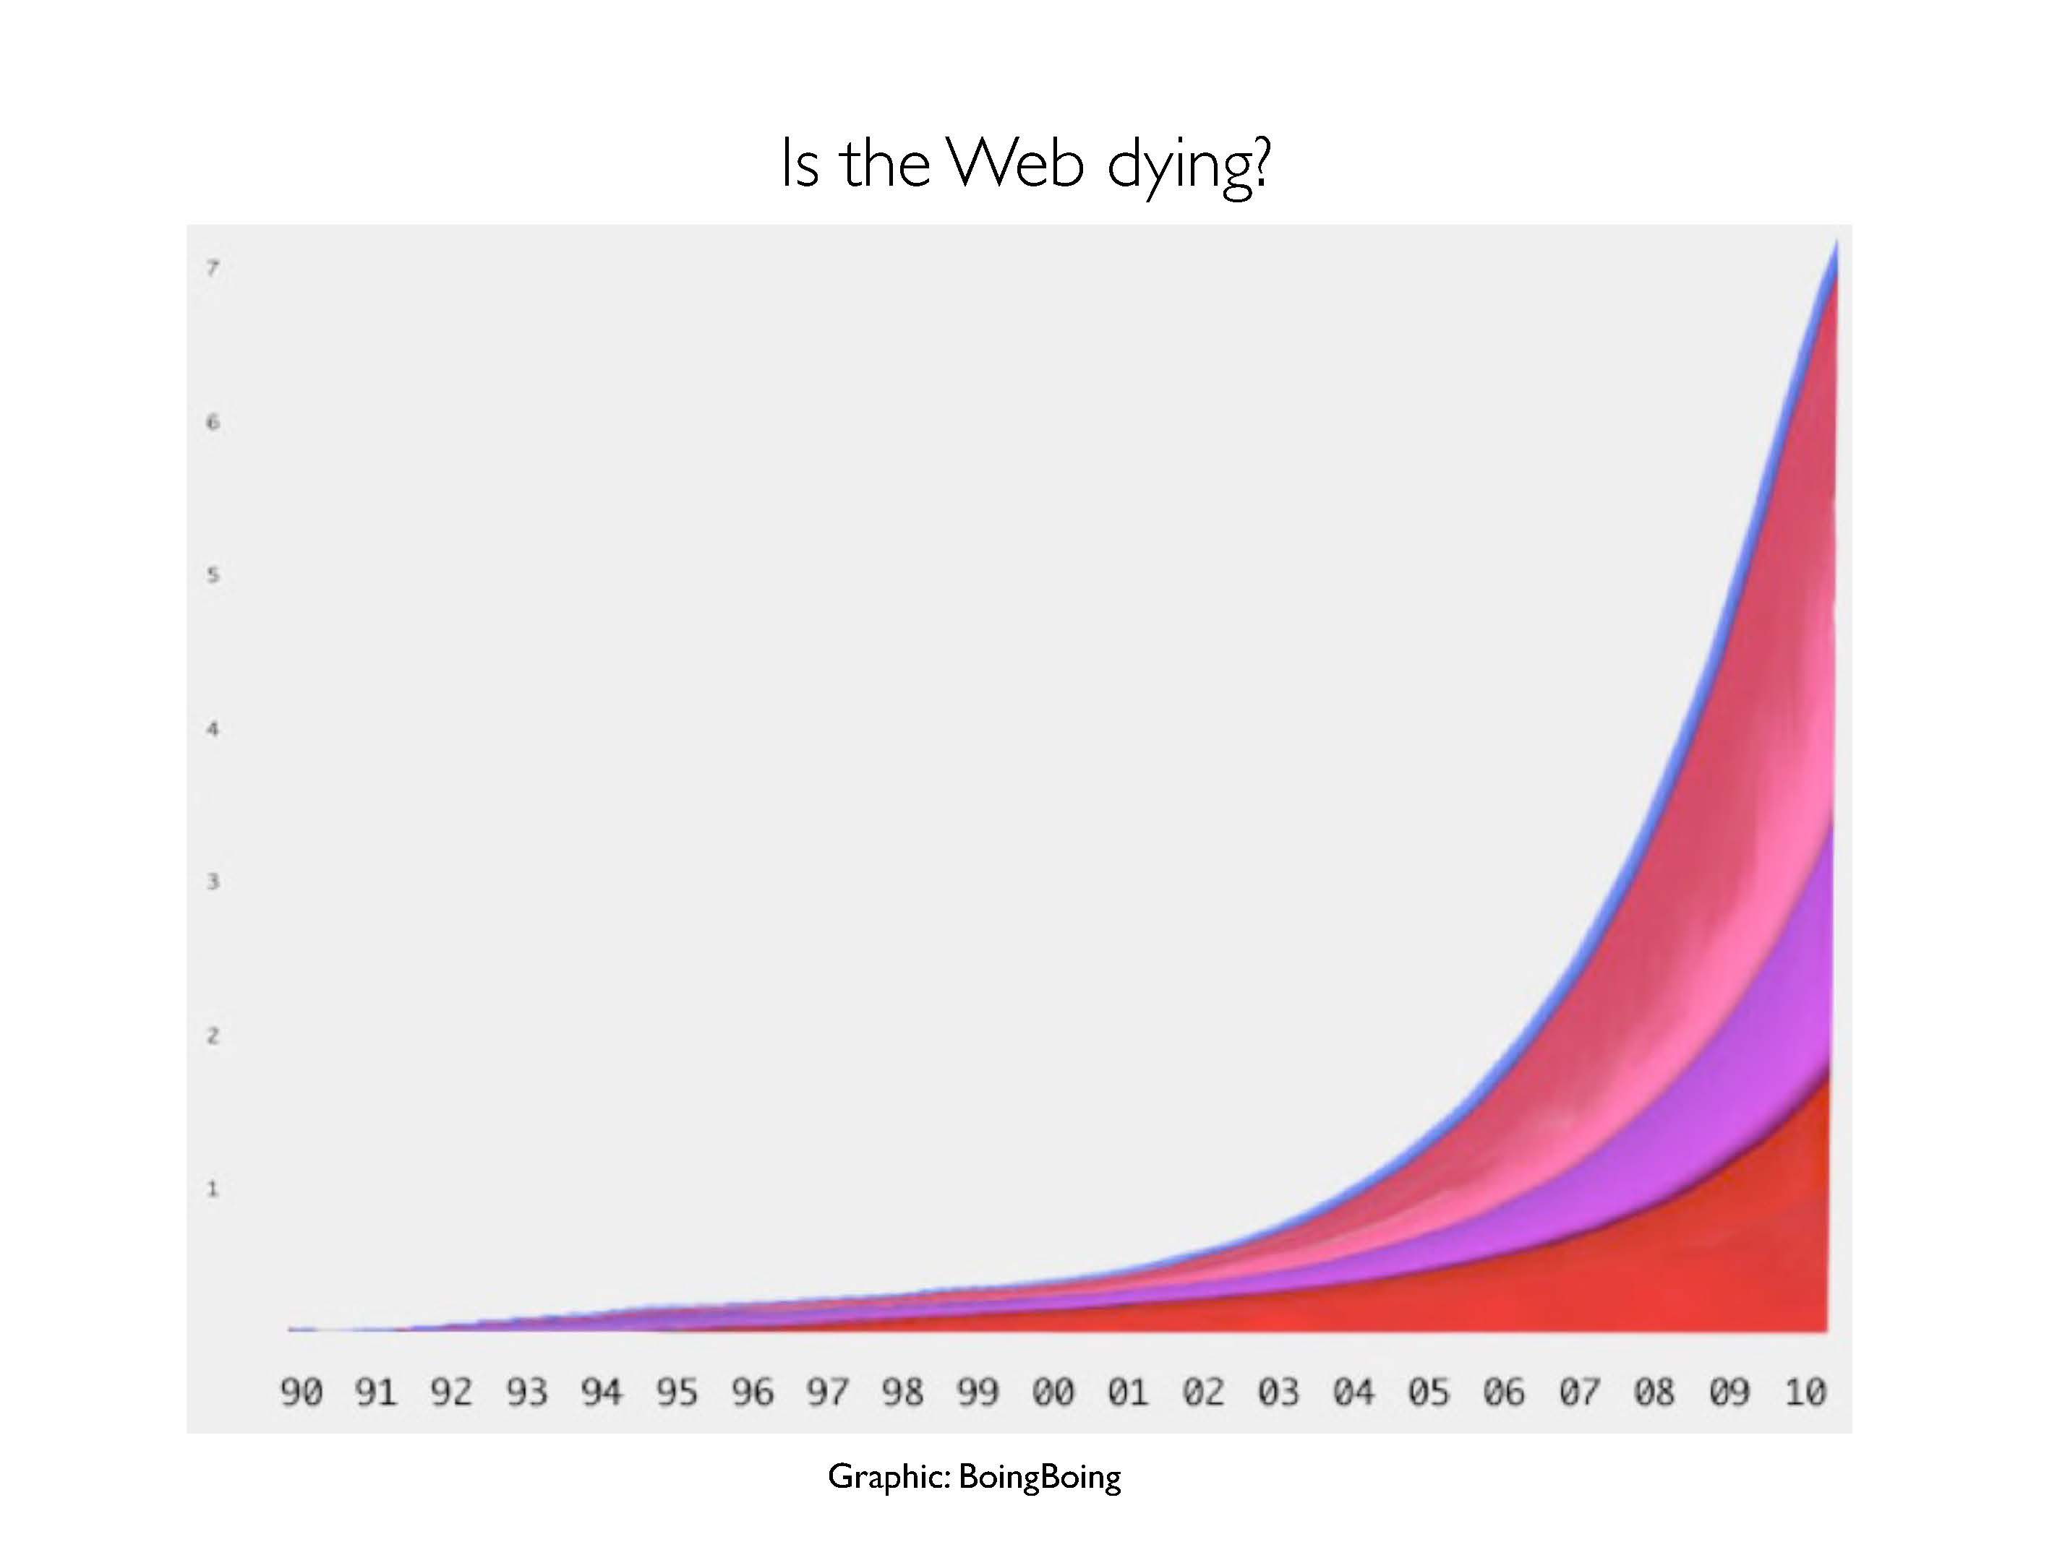

Slide 33
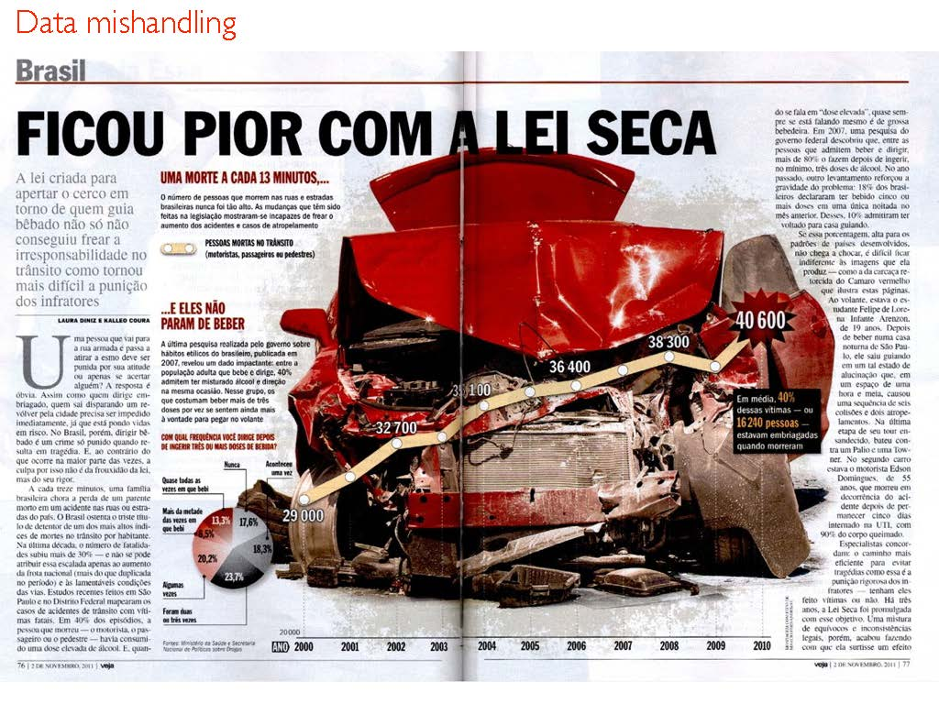

Slide 34
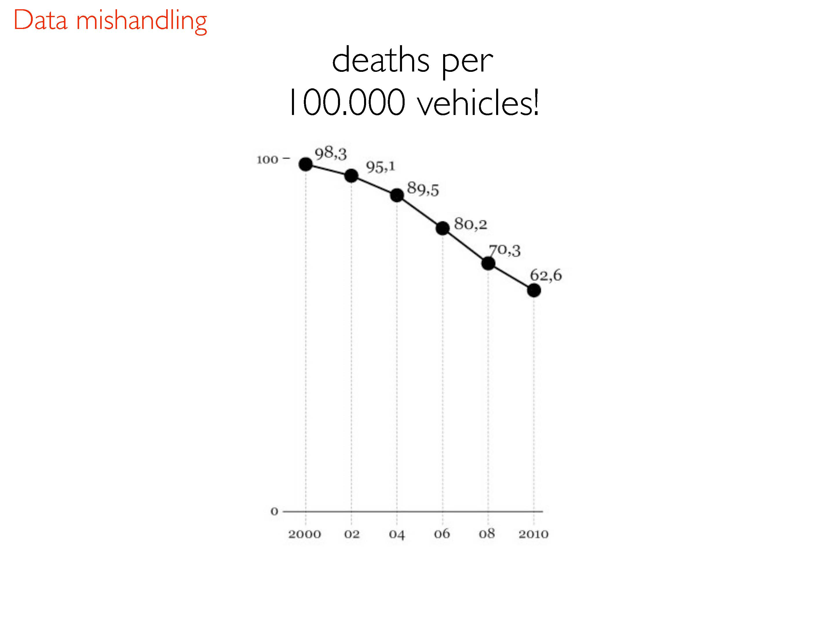

Slide 35
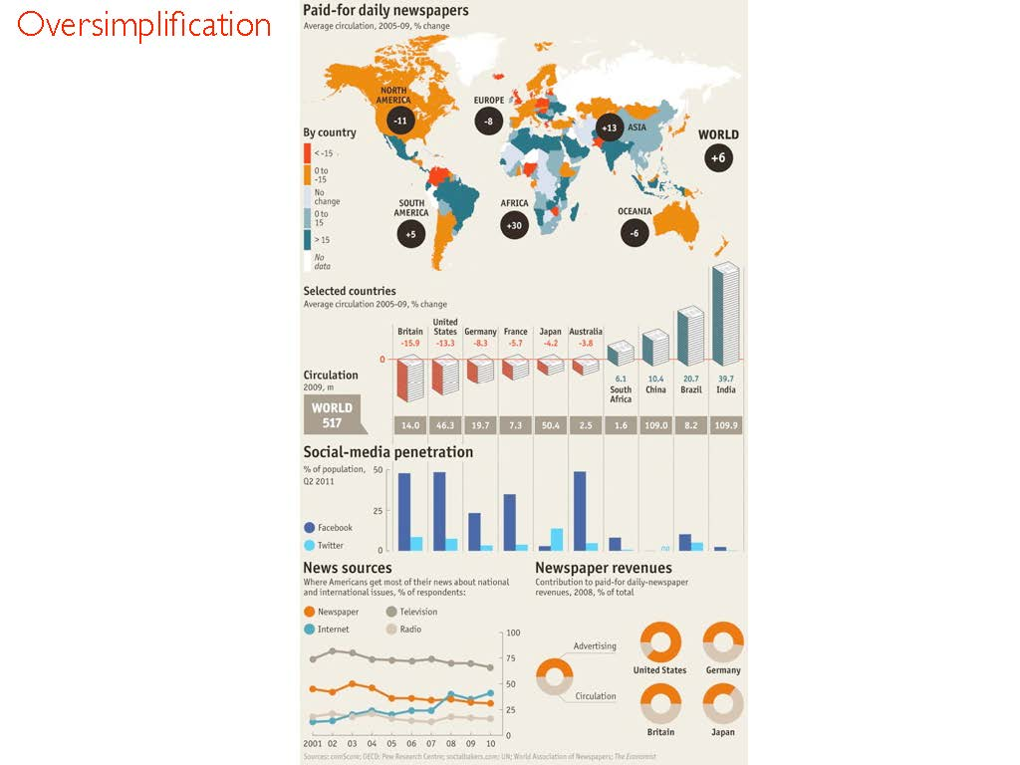

Slide 36
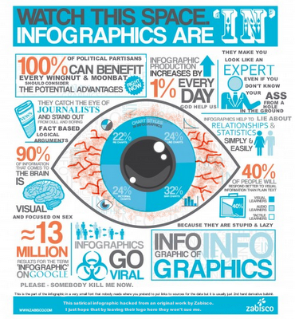
So what is an infographic?
Information graphics are tools to make stories understandable and to make the invisible visible.
Not This →

Slide 37
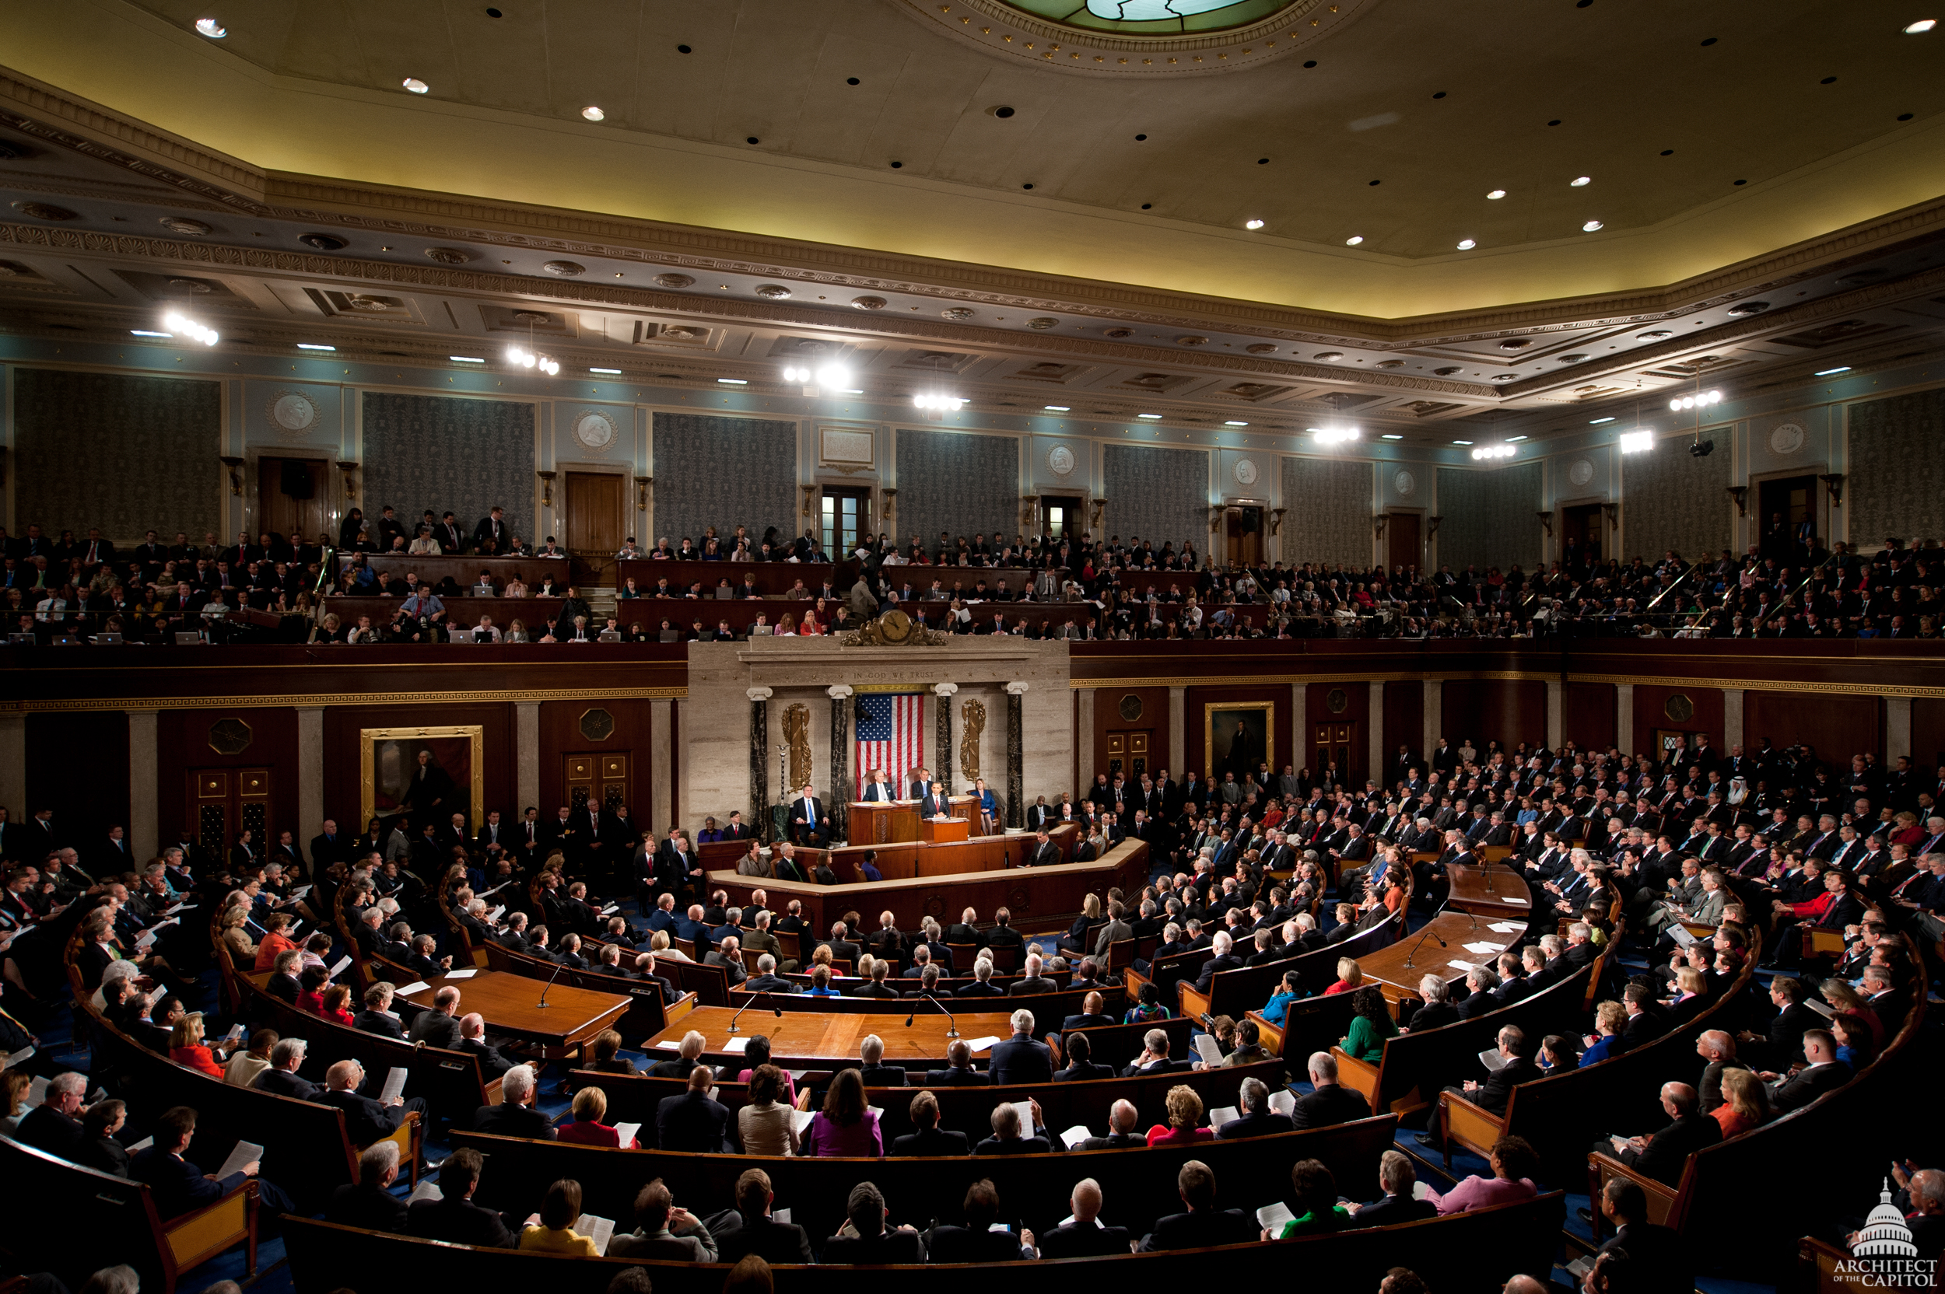
What does congress look like?

Slide 38
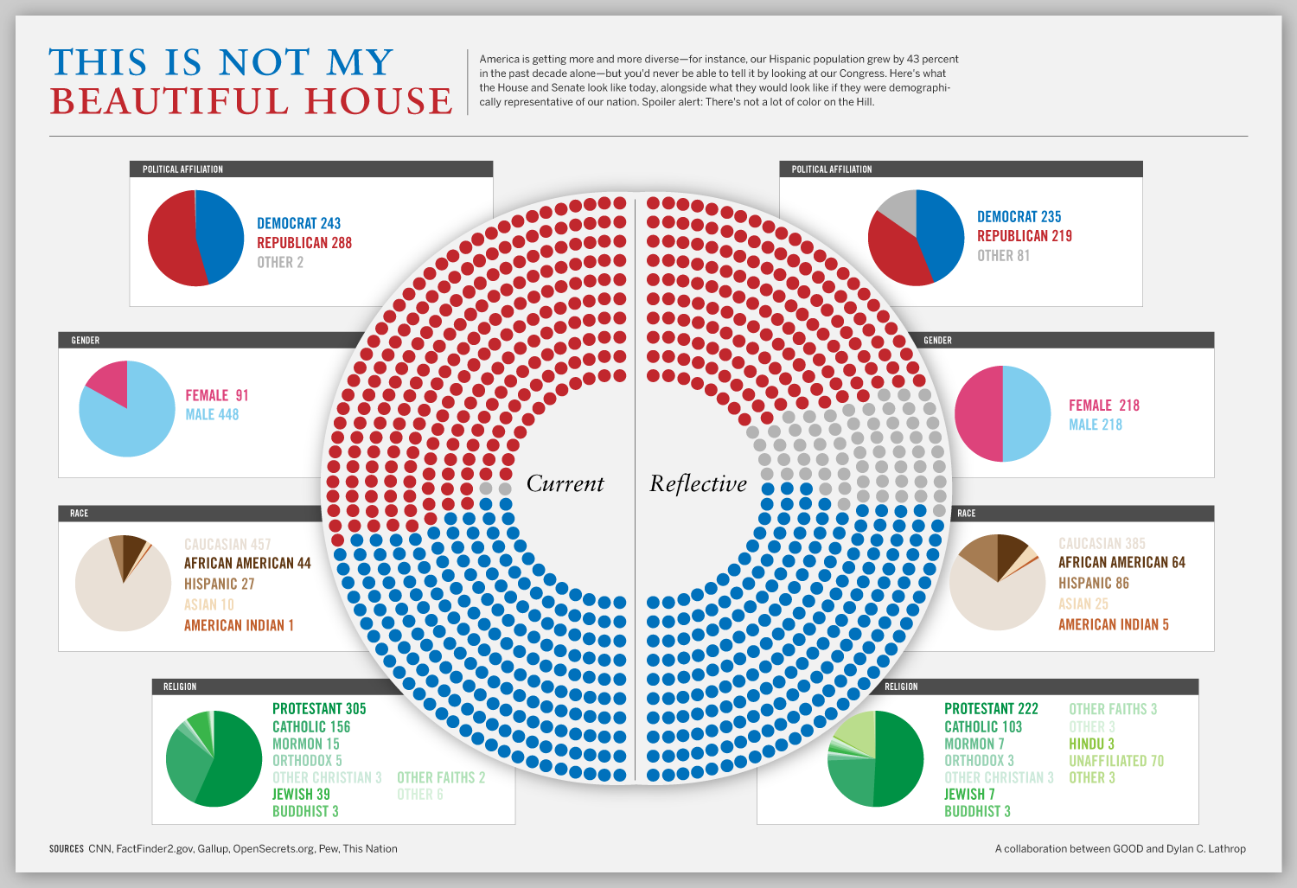

Slide 39
Learn from History
It’s important but I am going to go quick!

Slide 40
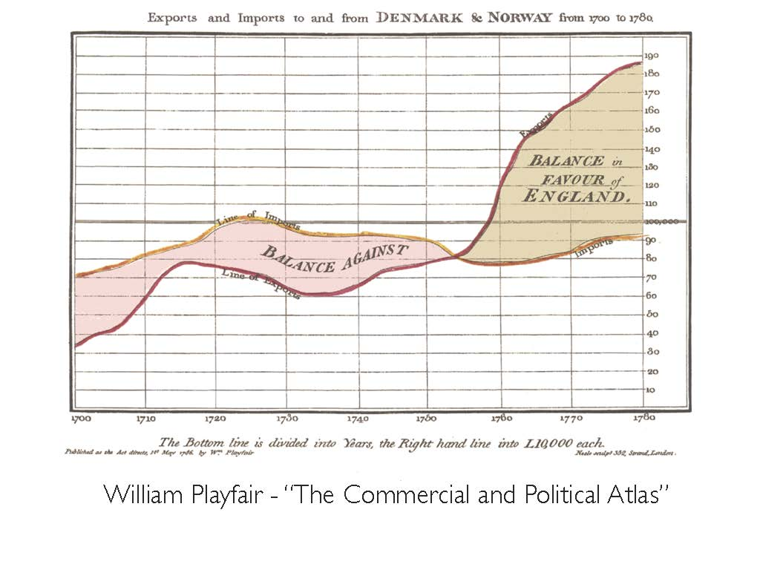
1776

Slide 41
William Playfair’s Atlas
To see numerical data as geometric shapes, he asserts, reveals its significance more quickly, makes it easier to remember, and saves time for those “of high rank, or active business” (Atlas, 1801, xiv).

Slide 42

1854

Slide 43
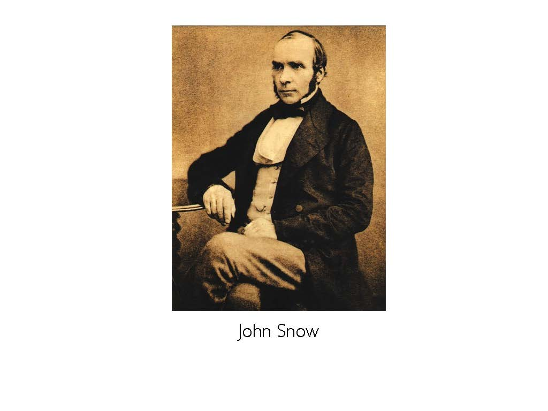
John Snow
Notes:
Snow used this spot map to illustrate how cases of cholera were centred around a water pump. This helped to show that cholera was being spread through the water, and not by air as was thought at the time. - See more at: http://visual.ly/john-snow-cholera-map#sthash.RPw8YjAu.dpuf

Slide 44
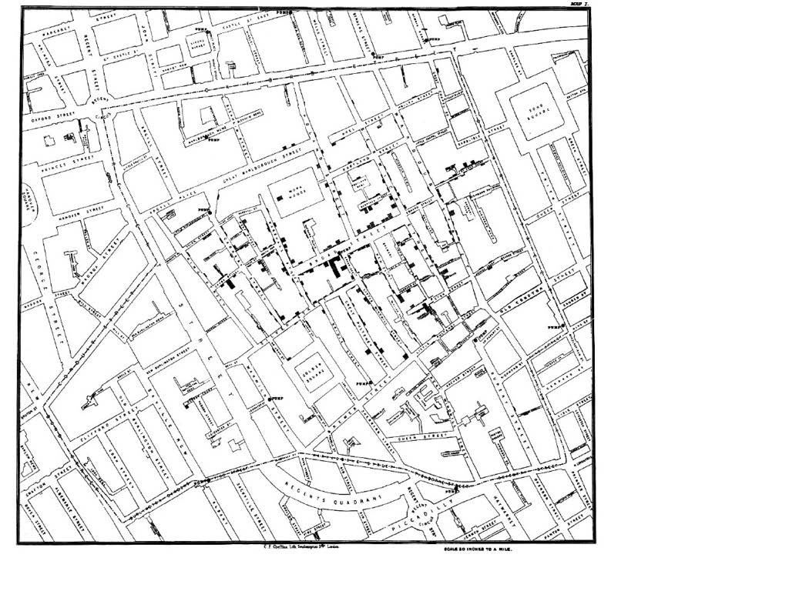

Slide 45
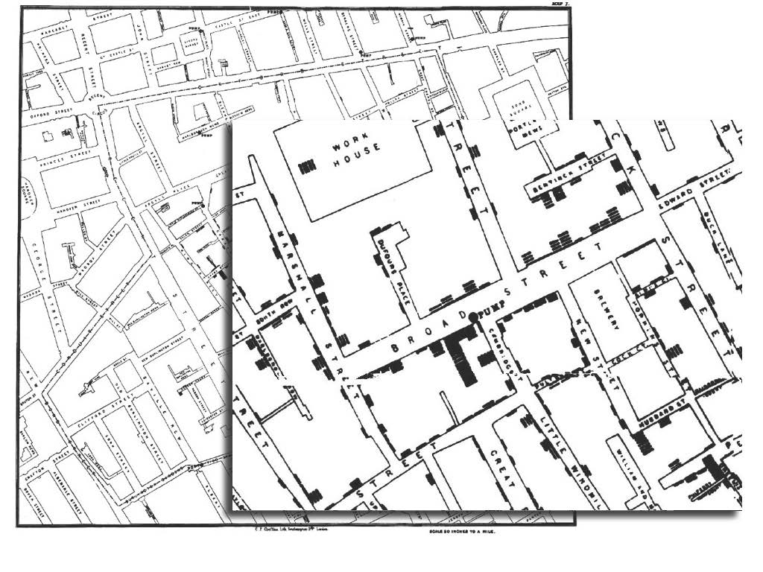

Slide 46
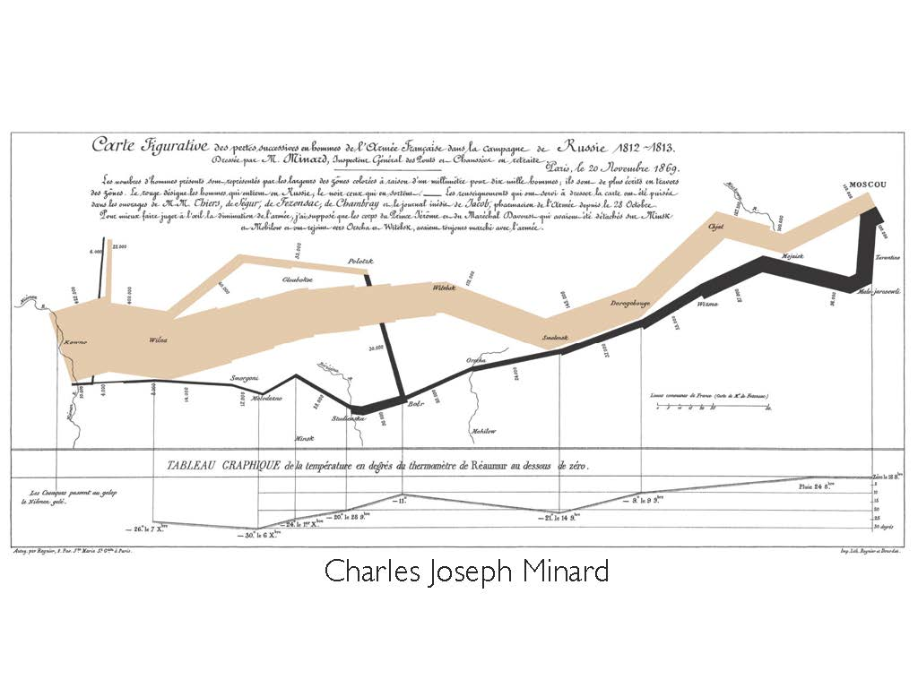
1869
Notes:
First flow map. Napalon’s disaster taking Moscow.

Slide 47
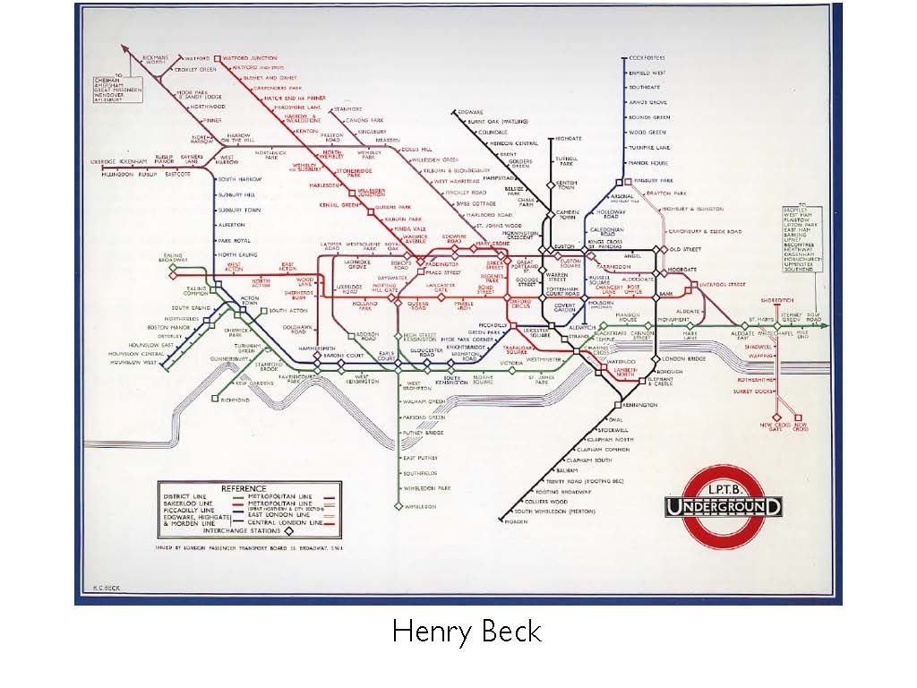
1933

Slide 48
Creating Graphics Projects
Process and Planning

Slide 49
Main Steps for any visualization project
Define the focus, the story, the goals, the task
Do some preliminary research
Choose graphic forms according to the data
Sketches and storyboards; structure the information
Complete the research and write the copy
Create the graphics, maps, and diagrams
Pull it all together

Slide 50
Data based narratives
When you don’t have a person, you can still have a story.

Slide 51
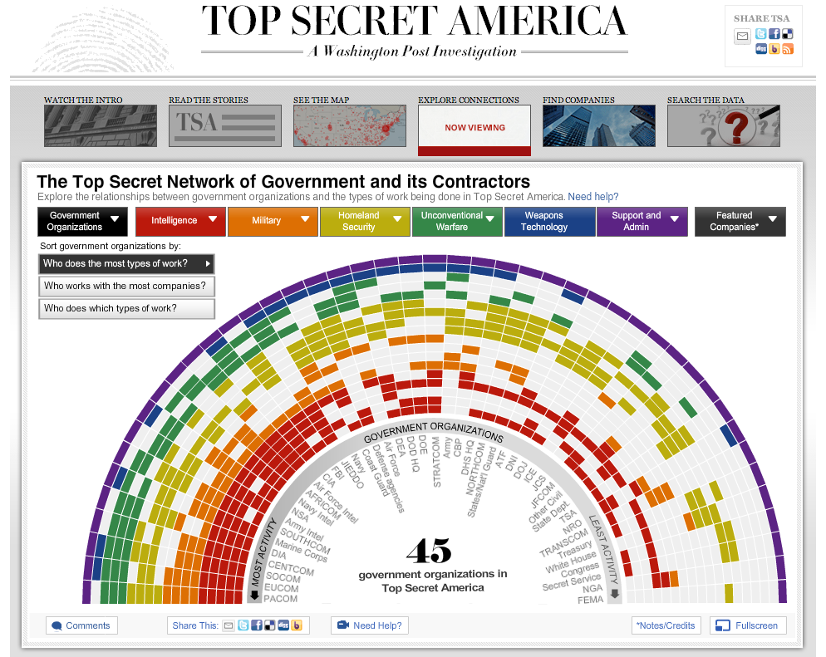
Top Secret America

Slide 52
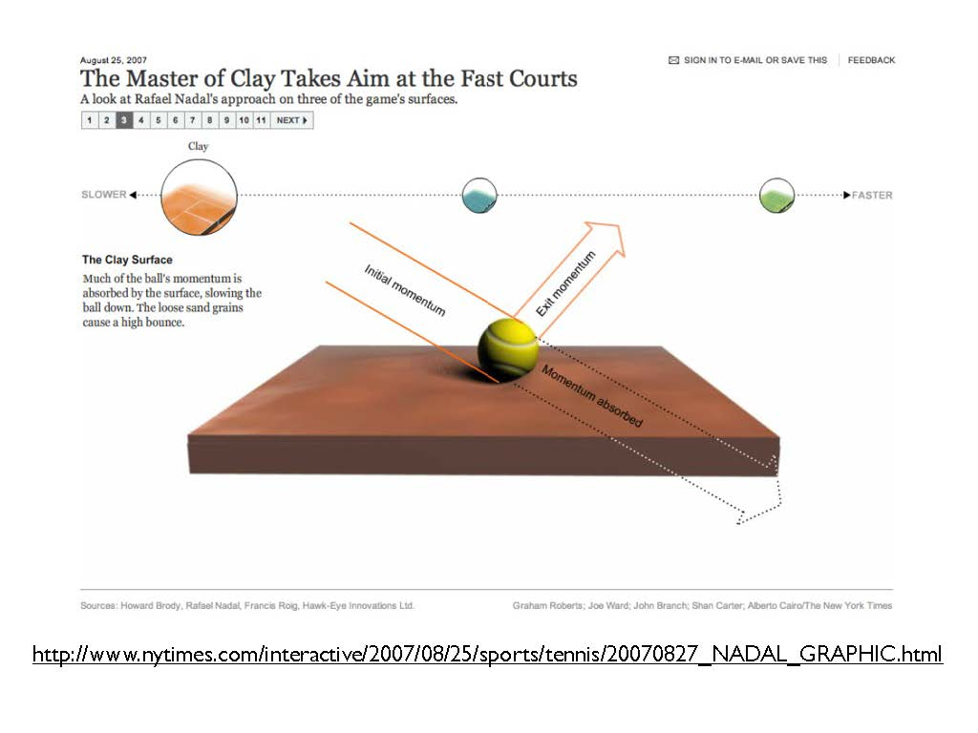

Slide 53
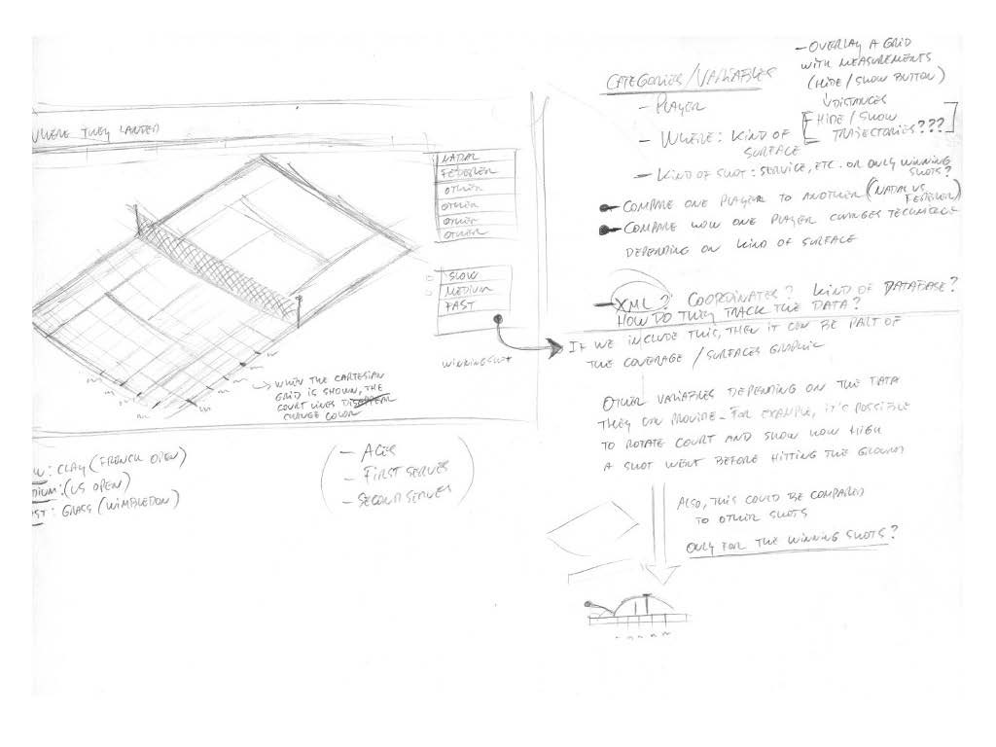

Slide 54
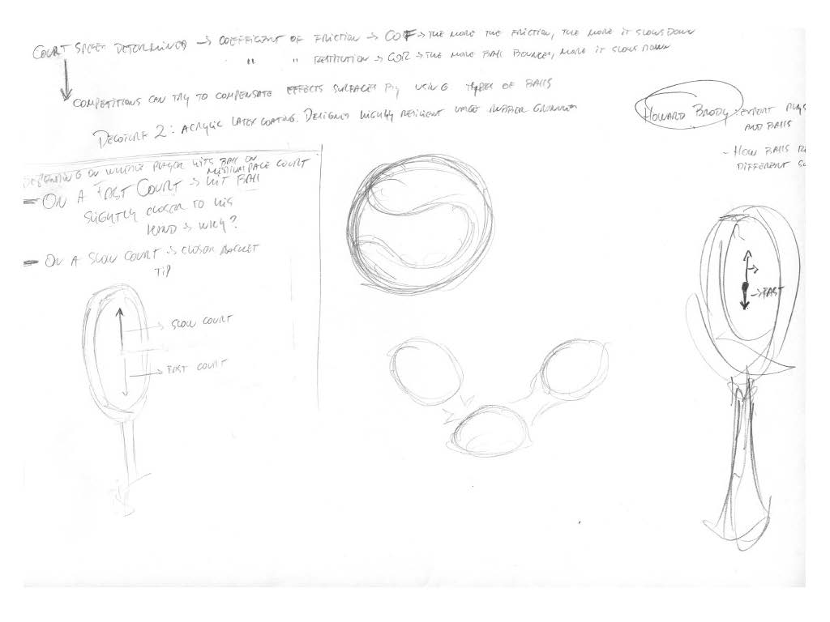

Slide 55
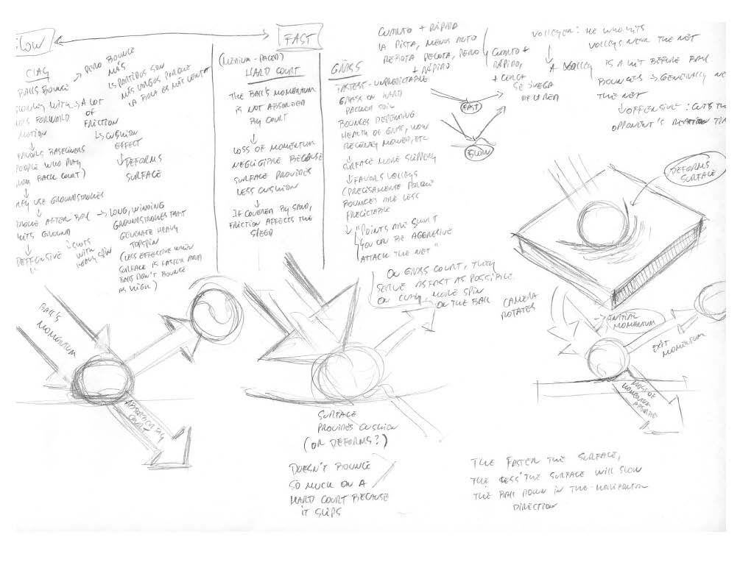

Slide 56
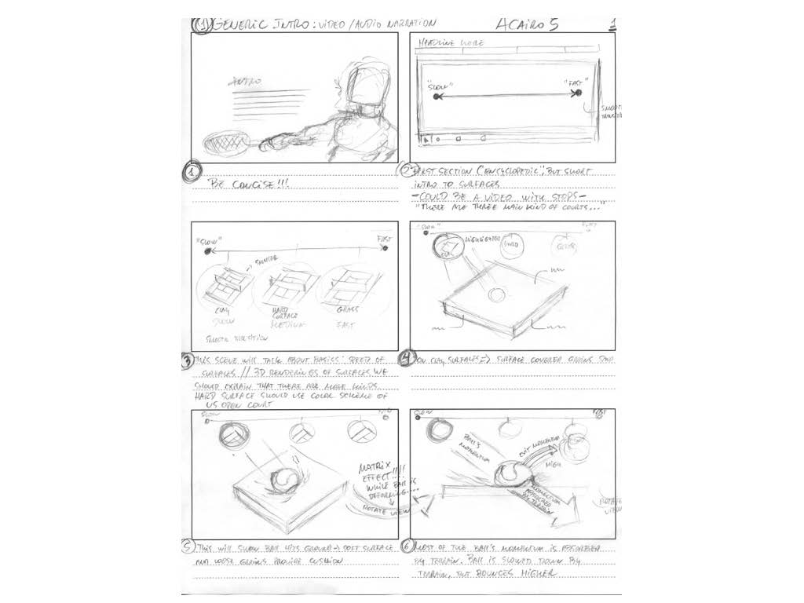

Slide 57
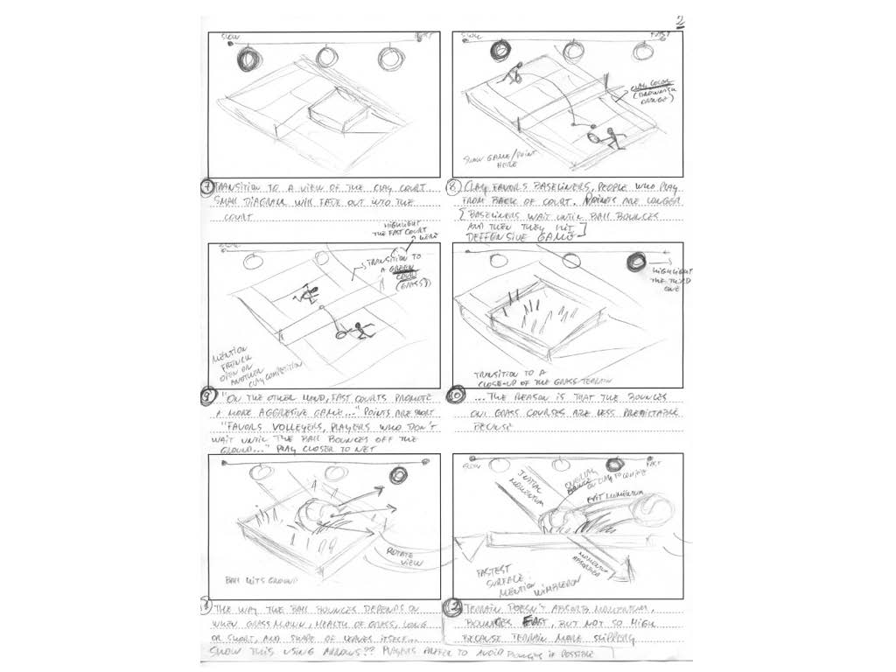

Slide 58
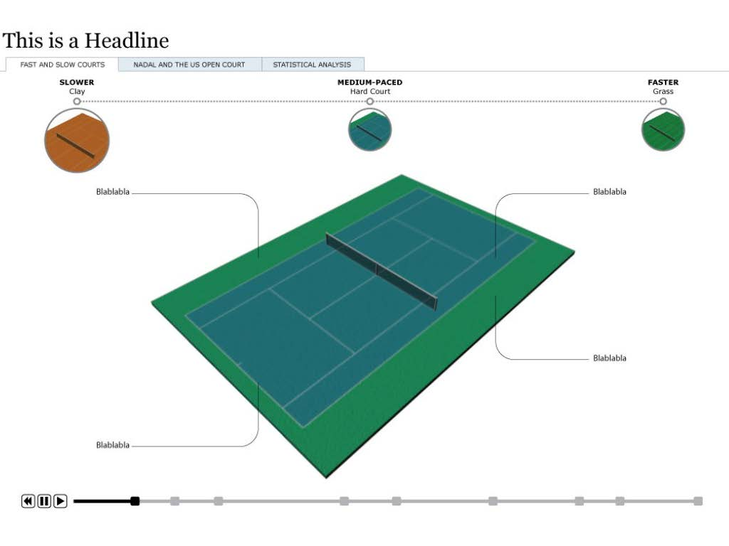

Slide 59
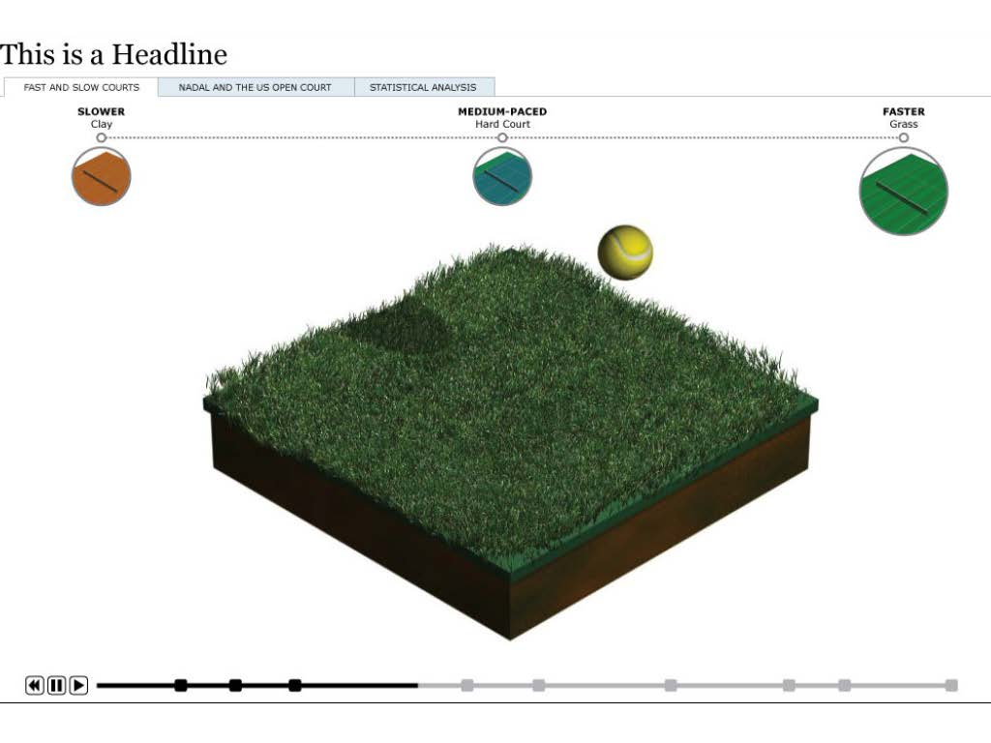

Slide 60
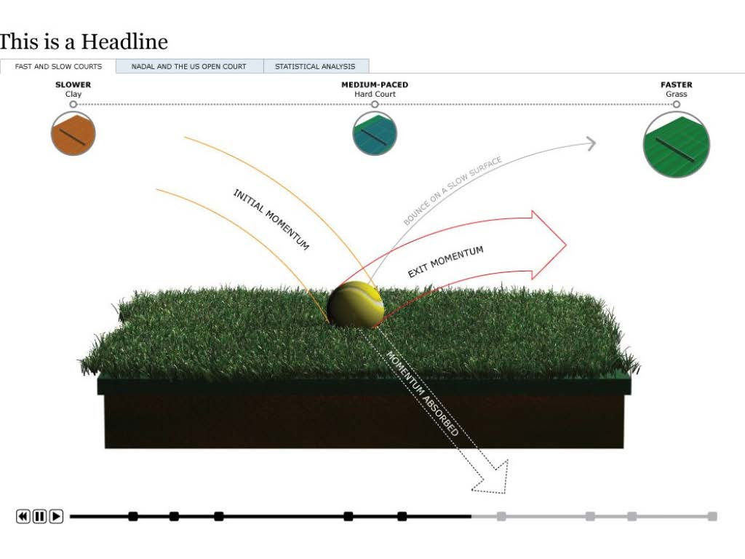

Slide 62
Trends in Online Graphics
Interactive Graphics

Slide 63

Motion Graphics
Notes:
http://www.nytimes.com/interactive/2012/08/05/sports/olympics/the-100-meter-dash-one-race-every-medalist-ever.html?_r=0

Slide 64

Data Graphics
Notes:
http://www.telegraph.co.uk/sport/football/competitions/premier-league/10811611/Premier-League-2013-14-The-craziest-title-race-ever.html

Slide 65

Interactive Games

Slide 66

Simulators and Calculators

Slide 67

Quizzes and Algorithm Interfaces

Slide 68
Graphical Forms
How to choose the right chart

Slide 69
Understand the Message You're Trying to Present with Your Data
We are trying to show one of four things with the data you have: a relationship between data points, a comparison of data points, a composition of data, or a distribution of data.

Slide 70
Relationship
A relationship tries to show a connection or correlation between two or more variables through the data presented, like the market cap of a given stock over time versus overall market trend.

Slide 71
Comparison
A comparison tries to set one set of variables apart from another, and display how those two variables interact, like the number of visitors to five competing web sites in a single month.

Slide 72
Composition
A composition tries to collect different types of information that make up a whole and display them together, like the search terms that those visitors used to land on your site, or how many of them came from links, search engines, or direct traffic.

Slide 73
Distribution
A distribution tries to lay out a collection of related or unrelated information simple to see how it correlates, if at all, and to understand if there's any interaction between the variables, like the number of bugs reported during each month of a beta.

Slide 74

Select the best graphical form or arrangement based on the Message.
What chart to choose?

Slide 76
Project 3

